Slide 1
Predicting daily Energy Consumption
Data science course final projecT – January 2021 – Rudy Malhi https://github.com/rudymalhi/data-science-course-final-project/blob/master/energy-consumption-v2.ipynb

Slide 2
The data
The main dataset contains ~60k records of the hourly energy consumption in the Chicago area (2004-2010)
Historical daily weather information for the area was obtained from the National Centers for Environmental Information (NCEI)

Slide 3
Preprocessing
The consumption data was grouped by date and merged with the daily weather data
While analyzing the data an outlier was found on the last day, probably caused by a partial reading, and was dropped
Using the holidays library a column was added to indicate a business day
A day of the week column was added

Slide 4
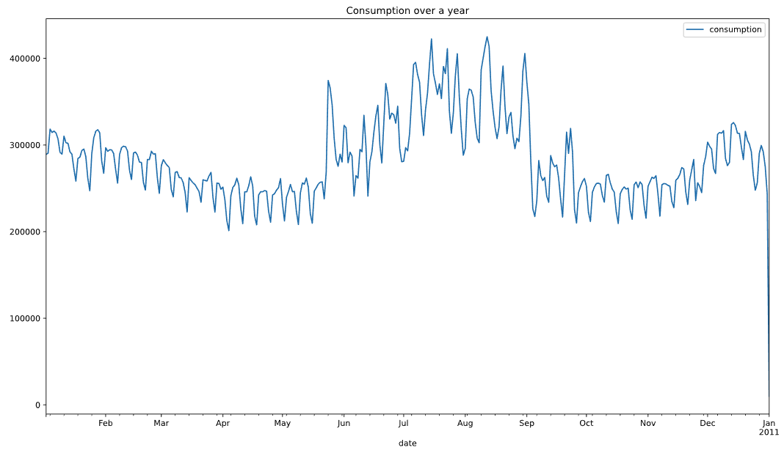
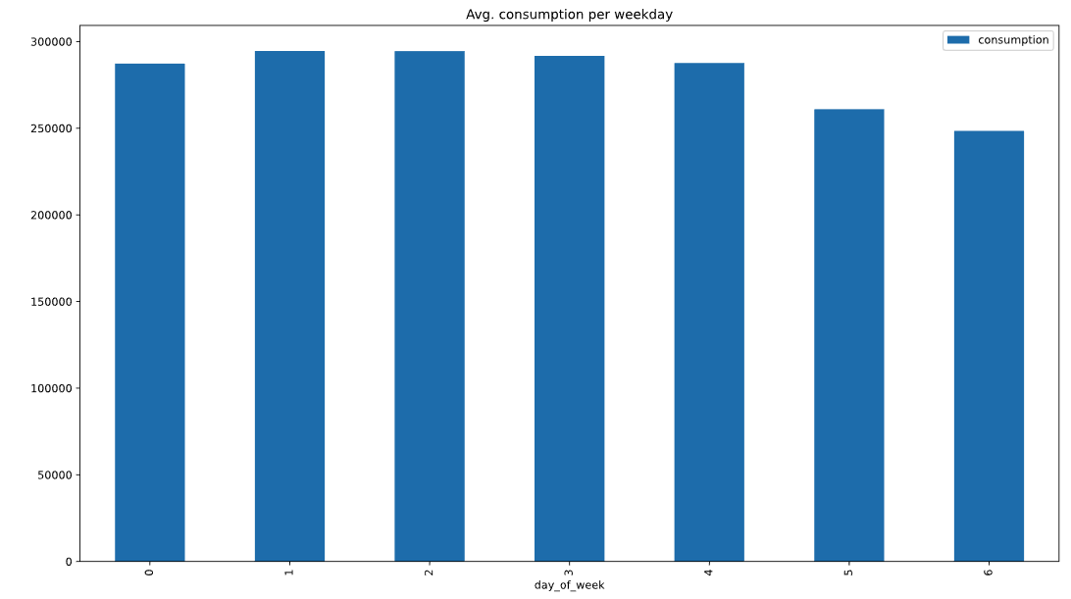
Visualisazions
Outlier

Slide 5
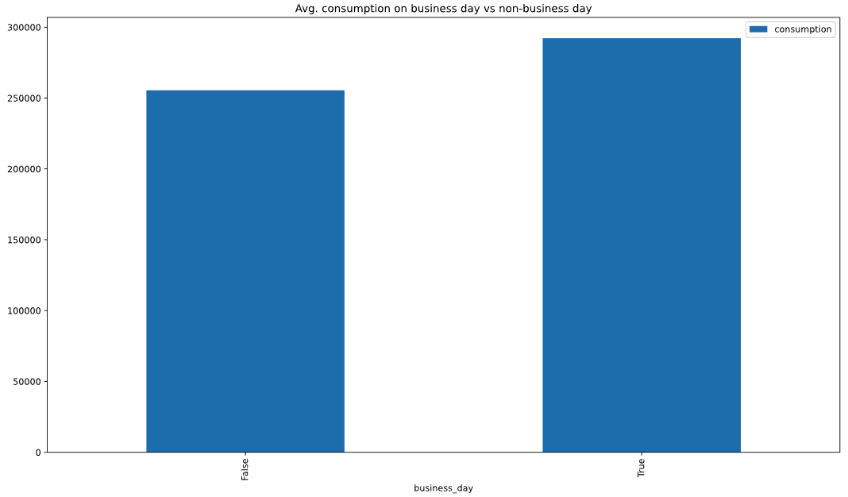
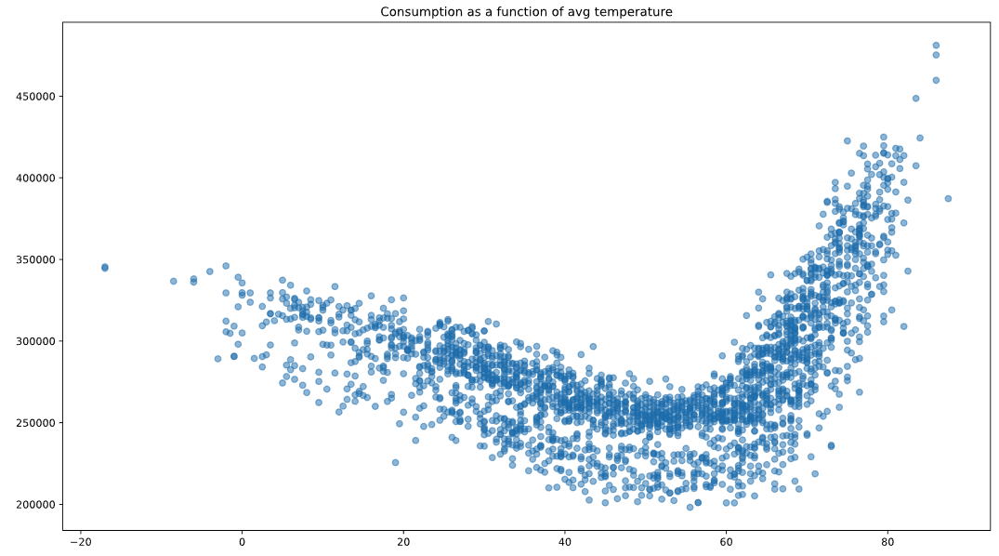
Visualizations (cont.)

Slide 6
Numeric Features
The numeric features are
Minimum daily temperature
Maximum daily temperature
Tansformations:
Polynomial transformation - there is clearly a curvilinear relationship between the temperature and the consumption
Standard scaler

Slide 7
categorical Features
The categorical features are
Business day
Day of the week
Tansformations:
One-hot encoding

Slide 8
Algorythm comparison
Linear Regression RMSE: 22,712
Ridge Regression RMSE: 16,218 Using grid search for tuning the alpha parameter and the polynomial degree
 | Consumption
Mean | 280,769
Std. deviation | 41,774
Min | 198,158
Max | 481,122

Slide 9
Improving the model
What if we added the temperatures of the prior day to the features?
RMSE: 16,202

Slide 10
Q&A

